Slide 1
Internship Report Company Name: Meliorate Technology Private Limited
Name: Yash Panchal Guide: Prof. Namrathaa Malu
Class: MSC CS
Roll No: 02
Employment type: Internship
Email: panchalyash089@gmail.com

Slide 2
Table Of contents
Problem Statement
Company Background
Responsibilities
Experiences and skills learned
Conclusion
ScreenShort of UI

Slide 3
Problem Statement
The existing system for converting PDF data into Excel using JXL module is typically a manual process that involves extracting data from PDF files and manually entering it into Excel format. This process is time-consuming and labor-intensive, especially when dealing with large volumes of PDF files or complex data structures.

Slide 4
Company Background:
Founded in 2018, Meliorate is an international software solutions provider for the Textile industry. The company has a presence in International markets as well and delivers innovative software solutions to both start-ups and established textile industry, through direct communication or a reliable partners network.
The company provides a challenging environment that encourages initiative and promotes commitment to its client’s business objectives.
The company’s only goal is to deliver client-centric solutions which will unlock more potential business for the client.

Slide 5
Responsibilities:
Meliorate transferred me to their Exim project.
I have been assigned as a Jr. Java Developer trainee to operate on Exim Solution software/Project.
The task is to convert the invoice, Annexure, and Packaging list generated between both parties into JSON and append it to the Excel Sheet to satisfy both the exporter and manufacturer.
The entire process is commenced in the java backend using the algorithm which is completely designed by me using JAVA.
Here I have developed and introduced with my colleagues, a merge concept for the JXL module which is proprietarily designed by us.

Slide 6
Experiences and skills learned:
Industry exposure specifically the textile industry
Worked on the JXL module and introduced the merge concept for it which solved the issue.
Hands-on experience working on live feeds and real-time.
Real-time activity is executed by using AWS.

Slide 7
Conclusion :
The work experiences I encountered during the internship allowed me to develop JXL, Spring Boot, and AWS.
The overall experience is positive, and everything I learned would be useful in my future career in this field.
The work experiences I encountered during the internship allowed me to develop Java and AWS.

Slide 8
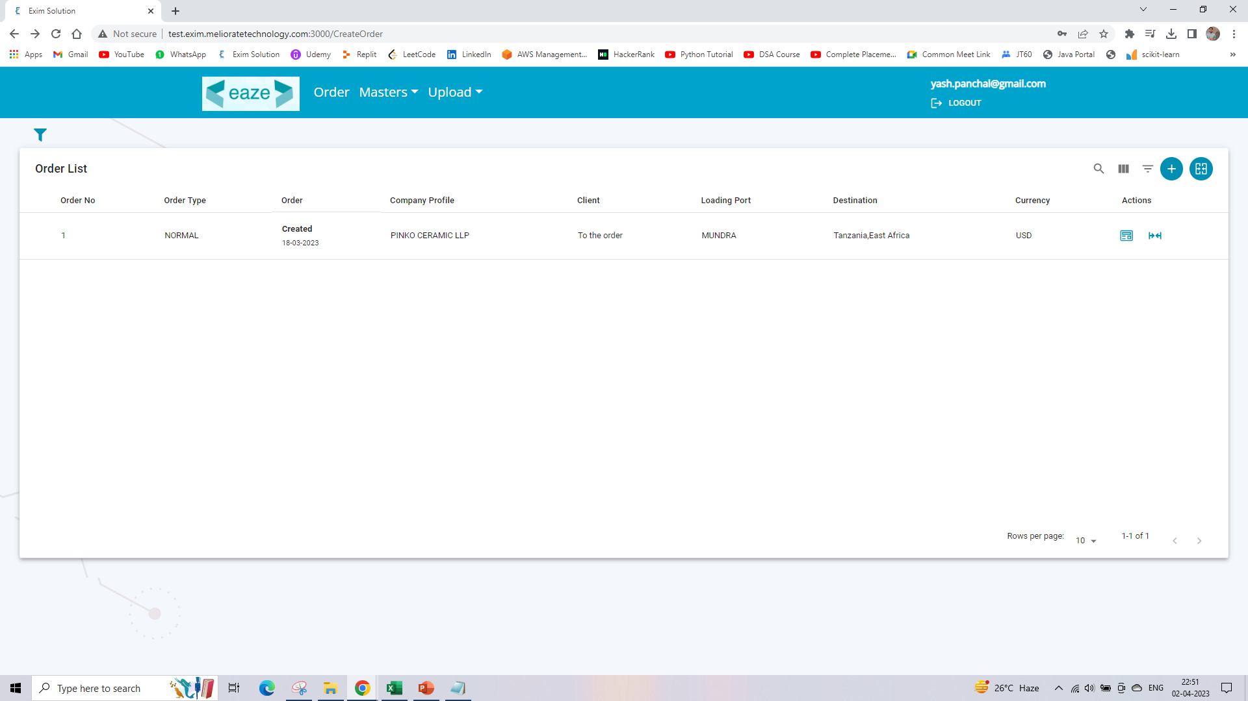

Slide 9
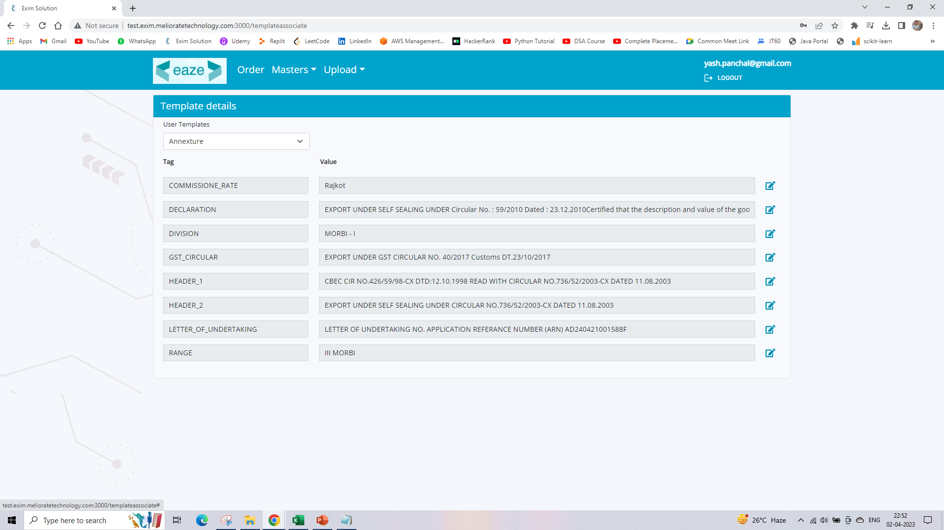

Slide 10
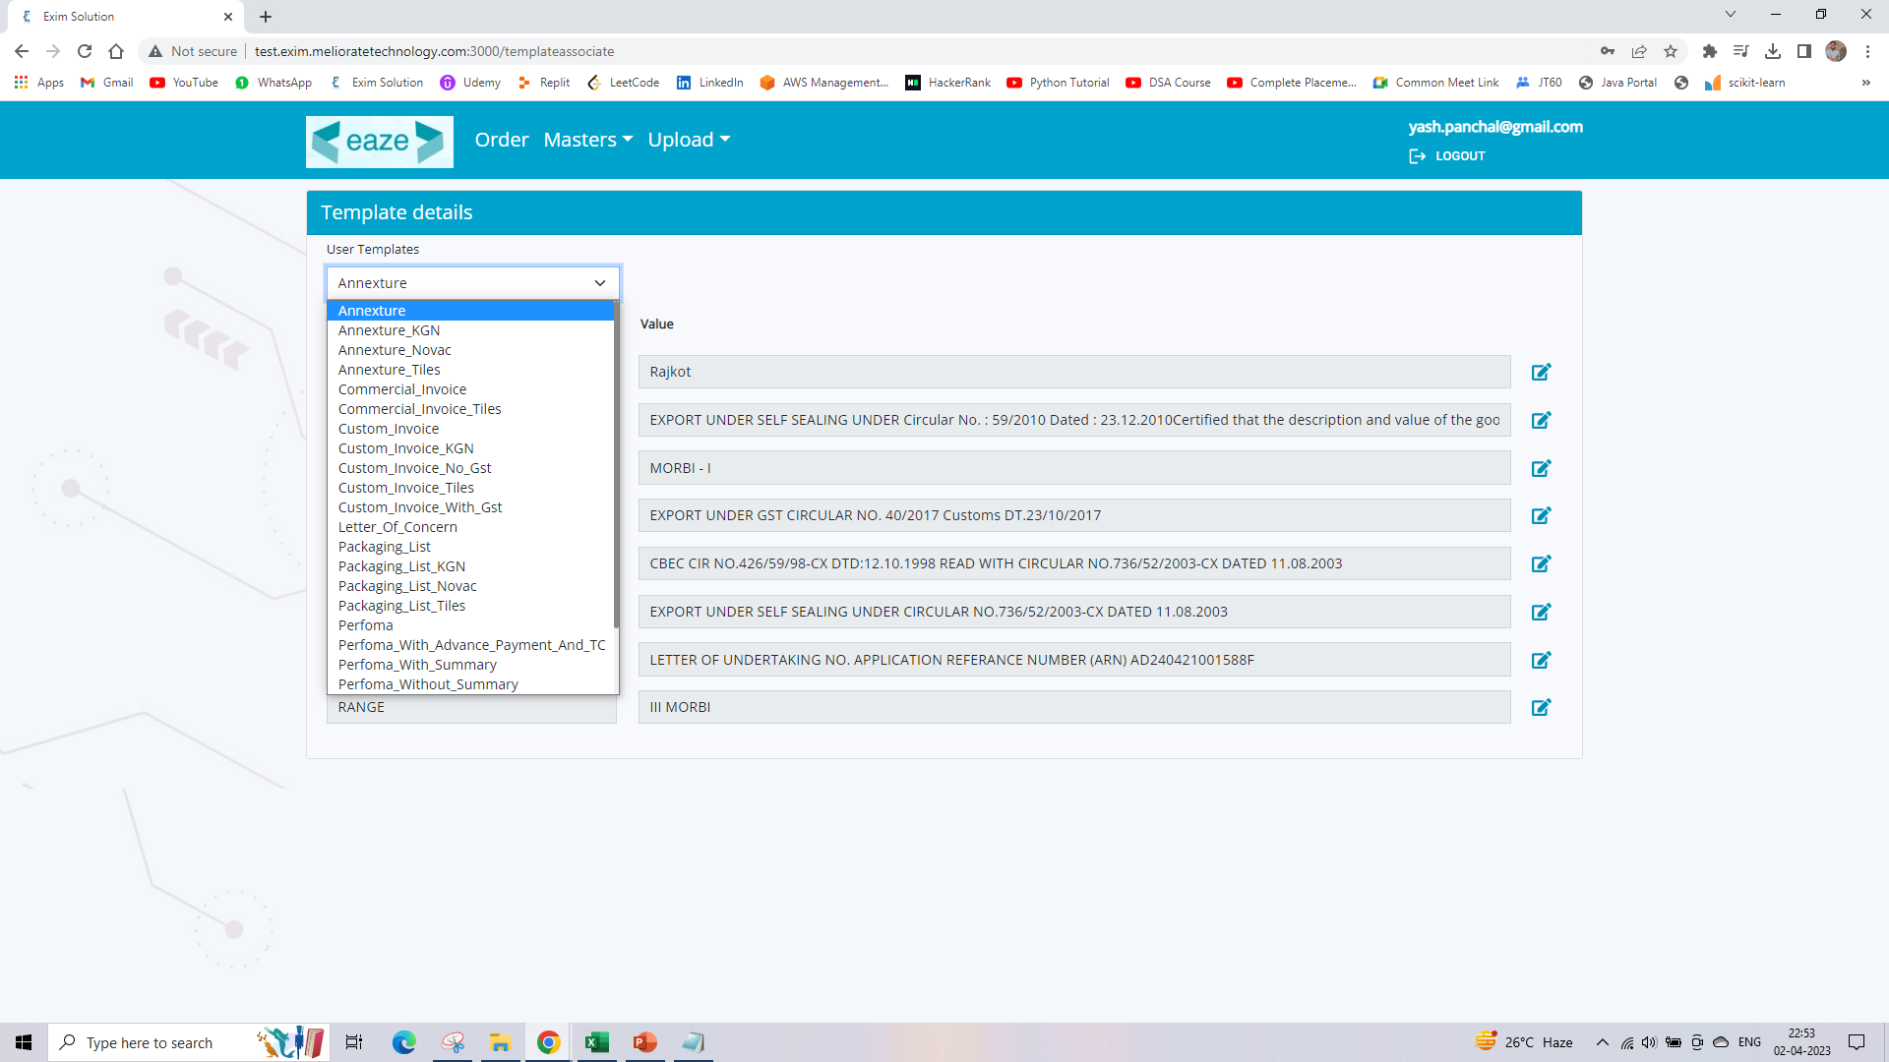

Slide 11
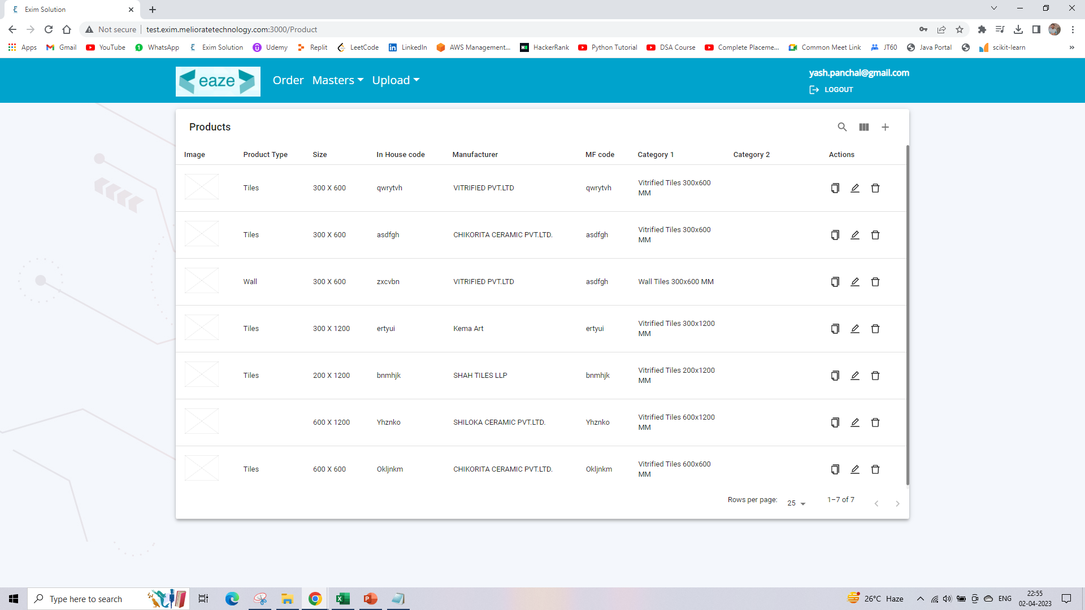

Slide 12
